Slide 1
Using Machine Learning methods for Geogenic Radon potential Mapping in Hessen
Master’s Thesis
Data exploration and processing
By: Augustine M Gbondo
TropHEE

Slide 2
Contents
Data required and acquired
VECTOR DATA
- Radon
- Geology
- Uranium
RASTER DATA
- Soil Hydraulic Properties
- Soil Physical Properties
- Soil Chemical Properties
Final Extracted Dataset *
Outstanding work
Feature selection, Modelling selection and performance metrics
Thesis & Publishing best model result online (webmap)

Slide 3
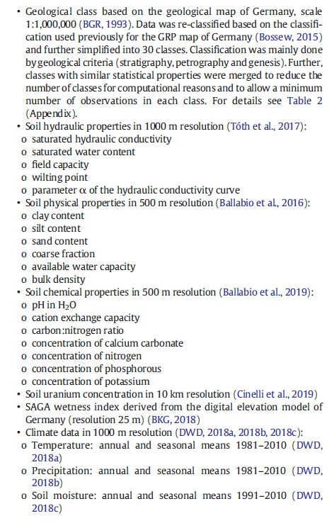
Data Required & Acquired
Field Data
(GRP data)
Predictor Data
1:300k Geological Map
Lineament Map
→later processed
All above data acquired and further processed

Slide 4
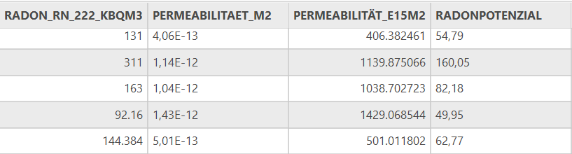
Vector Data
RADON DATA
Projected CRS: ETRS89 / UTM zone 32N EPSG : 25832
This CRS was used for the whole data exploration and cleaning process
Radon Measurement data
Two data sets
Bodenluftmessungen_Hessische_Radonstrategie[BHR] (696, 71)
Bodenluftmessungen_Weitere [BW] (255, 68)
Total of 951 measured points
Preliminary data exploration
Radon 222 (Bqm3) & (KBqm3)
For Dataset ‘BW’
- PERMEABILITÄT_E15M2 = 59 available
corresponding to the GRP
Huge difference in permeability readings
- BHR range = 0.02 - 225
- BW range = 19 - 2396
Dataset BW

Slide 5
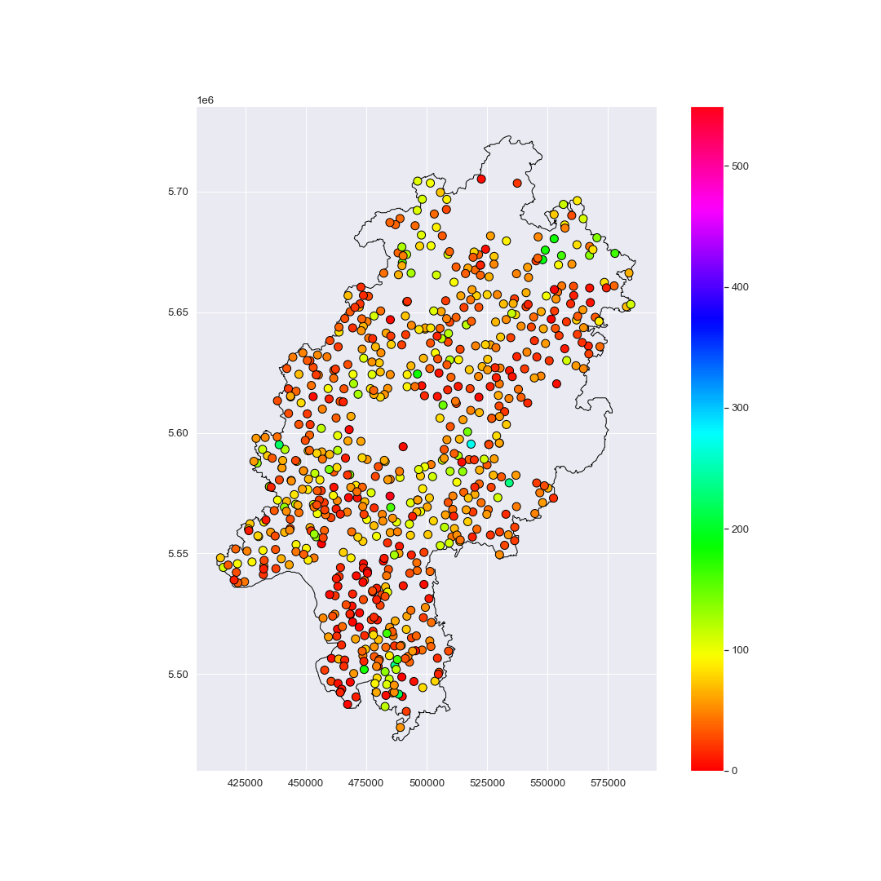
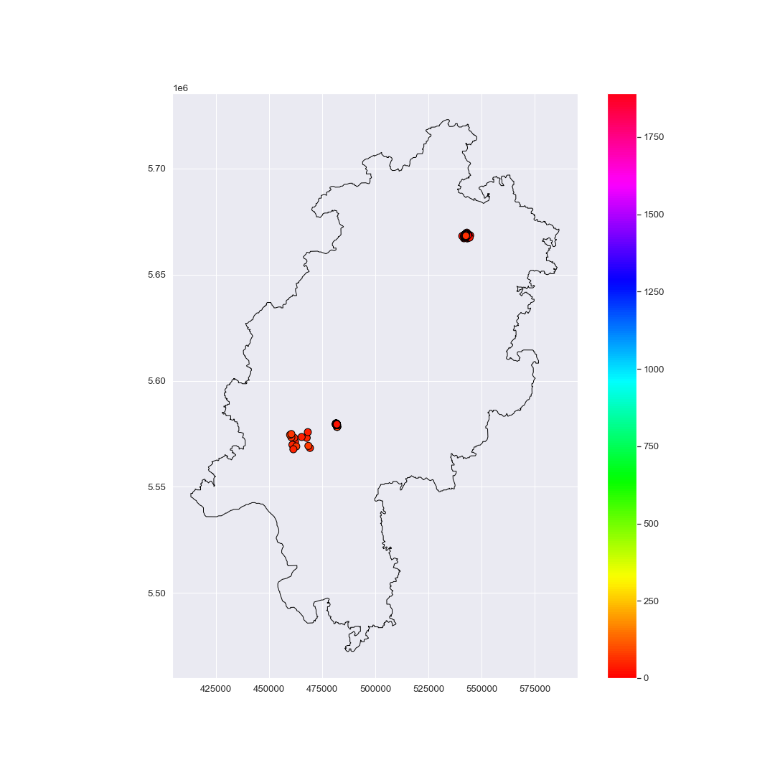
Vector Data
Maps
Radon Data
Bodenluftmessungen_Hessische_Radonstrategie
Bodenluftmessungen_Weitere
Sampling no. = 255
Sampling no. = 696
Projected CRS: ETRS89 / UTM zone 32N
EPSG : 25832

Slide 6
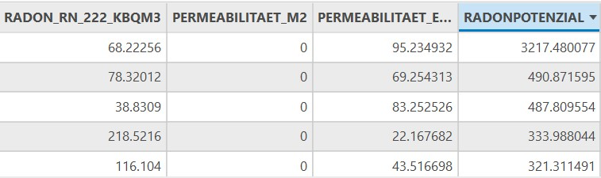
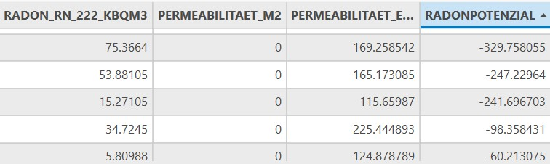
Vector Data
RADONPOTENZIAL
Data Cleaning
Extremely high values
Radon data
Merged dataset
951 data pts, 95 features (attributes)
removed
Negative values
Features of Interest
GK300_GEOL
RADON_RN_222_KBQM3
RADON_RN_222_BQL
PERMEABILITÄT_E15M2
RADONPOTENZIAL
RADONKONZE
removed
Column Formatting
-- Reformat column to float
-- Replace (“,” with “.”
https://www.health.state.mn.us

Slide 7
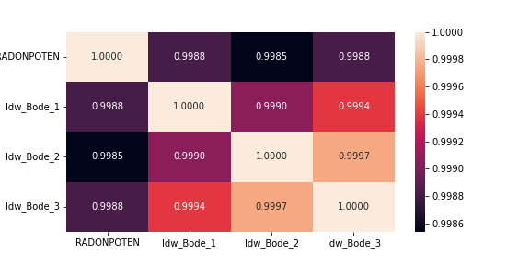
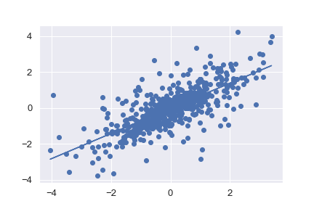
Vector Data
Filling N/A Data
Correlation and regression of ‘BHR Map’
Data is available
2. Using GRP/CRn eq.
GRP = CRn / (−log10 (k) − 10)
(Method ineligible because)
K map values are negative values
3. Correlation and regression of ‘BHR Map’
(Method ineligible because)
Many factors affect CRn
Parameter ‘k’ is not always continue in space
--Strong correlation between [Observed and Modelled
RADONPOTENIAL for IDW interpolation
CRN (KBqm3
-- Regression equation shows strong promise
Radon Poten

Slide 8
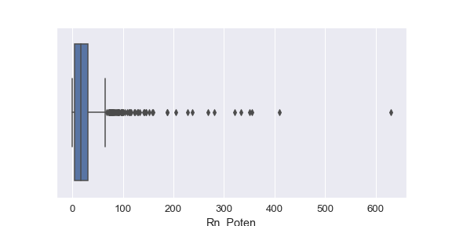
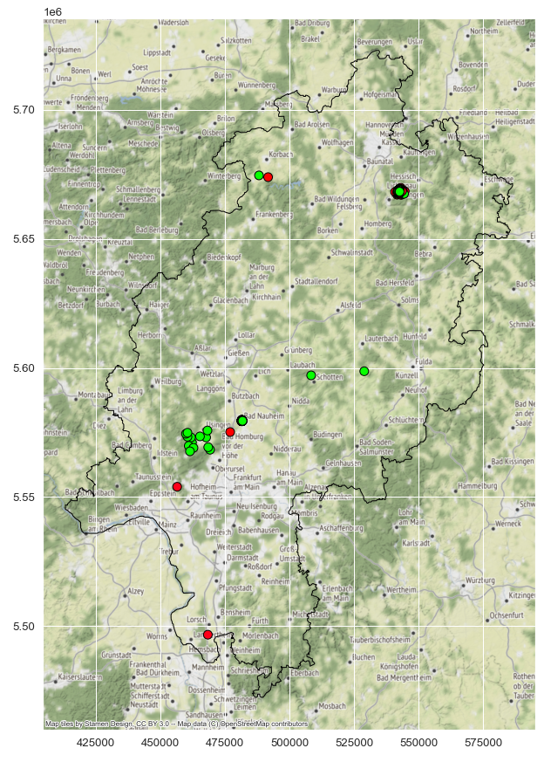
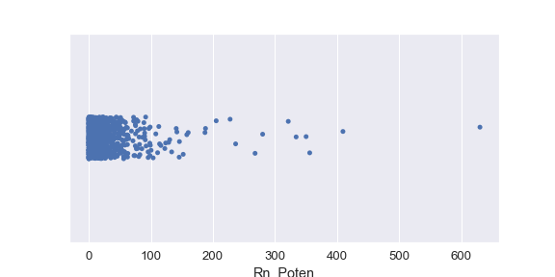
Vector Data
3. Correlation and regression of ‘BHR Map’
Dealing with Outliers
Box plot of GRP
Box plot stats
Mean = 26.1
iqr = 25.1
q1 = 4.8
median = 17.1
q3 = 29.9
-- Bad Nauheim and Kerenbach have the highest number of null values
Strip plot of GRP
-- Most values are below 100 KBqm3

Slide 9
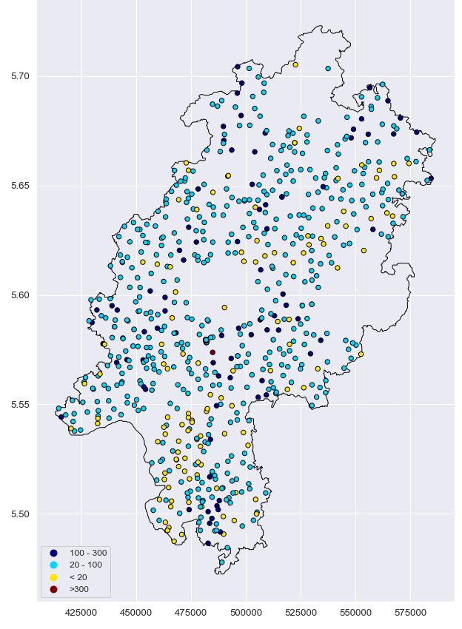
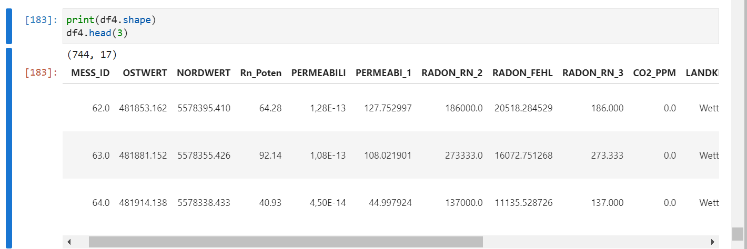
Vector Data
3. Correlation and regression of ‘BHR Map’
Final Data set
Features of interest
Strata (hlnug)
Rn222 conc. (Bqlm3)
Rn222 conc. (KBqlm3)
Rn222 conc. (Intervals)
Permeability (e-15m2)
Cordinates & Geometry(for python interface)
Landkreis
-- Final Measure points of 744

Slide 10
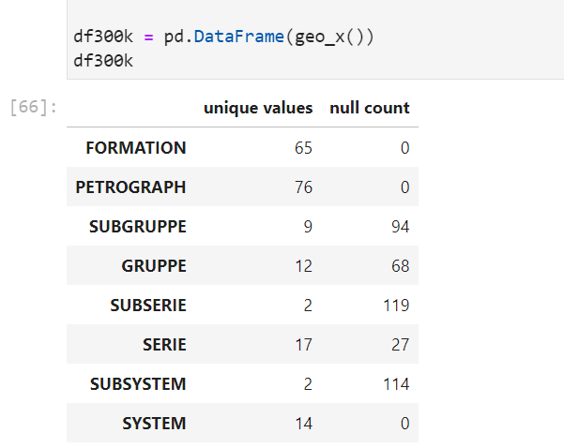
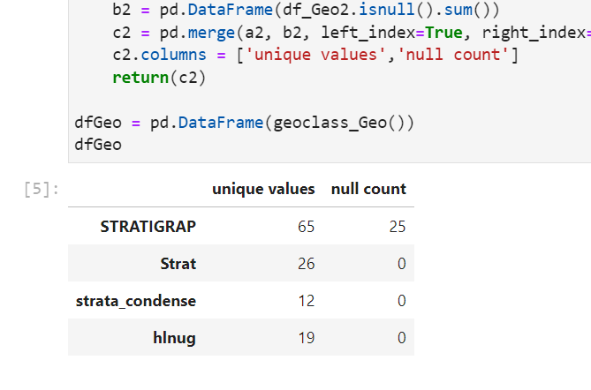
Vector Data
GEOLOGY DATA
Geology data
Two data sets
GUEK300_GEOLOGIE (176, 11)
GUEK300_englisch_Laura_Eck_2021 (176, 13)
Total of 176 polygon geometries in each dataset
-- GUEK300_GEOLOGIE
- 8 different Geology classification
- Only FORMATION, PETROGRAPH and SYSTEM has complete dataset
Projected CRS: ETRS89 / UTM zone 32N EPSG : 25832
-- GUEK300_Laura_Eck
- 4 different Geology classification
- Only STRAT, ‘strat_condense’ and ‘hlnug’ has complete dataset

Slide 11
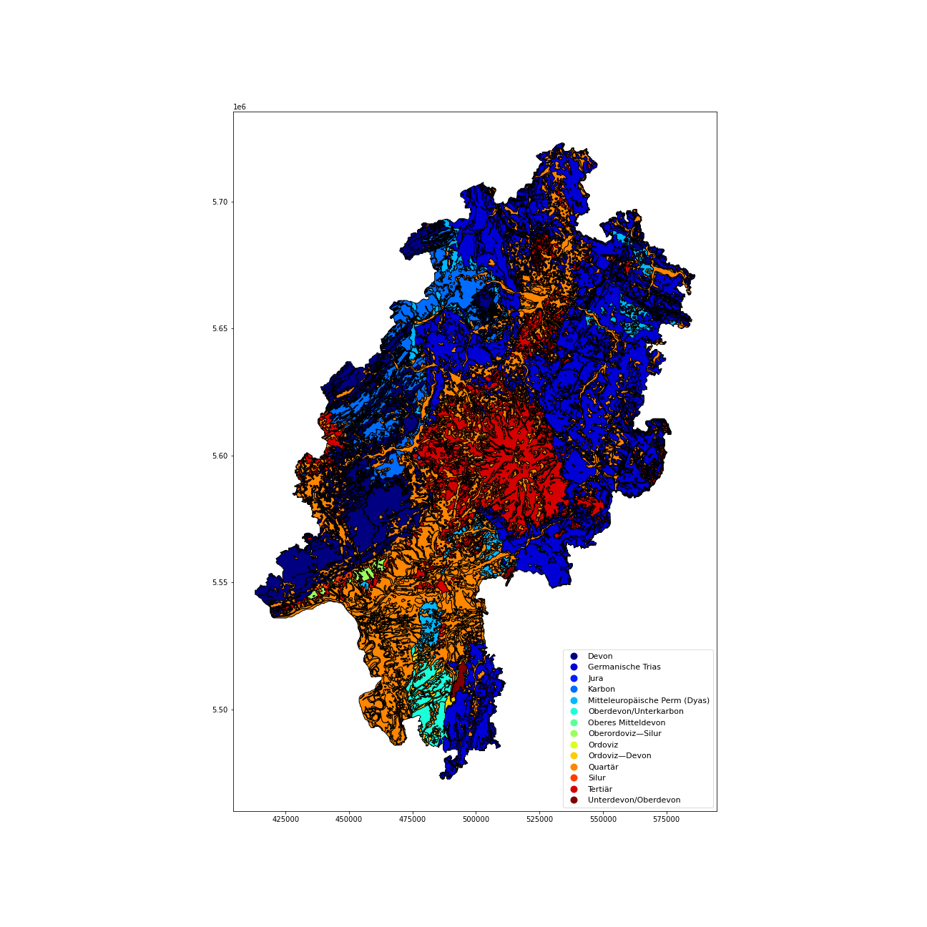
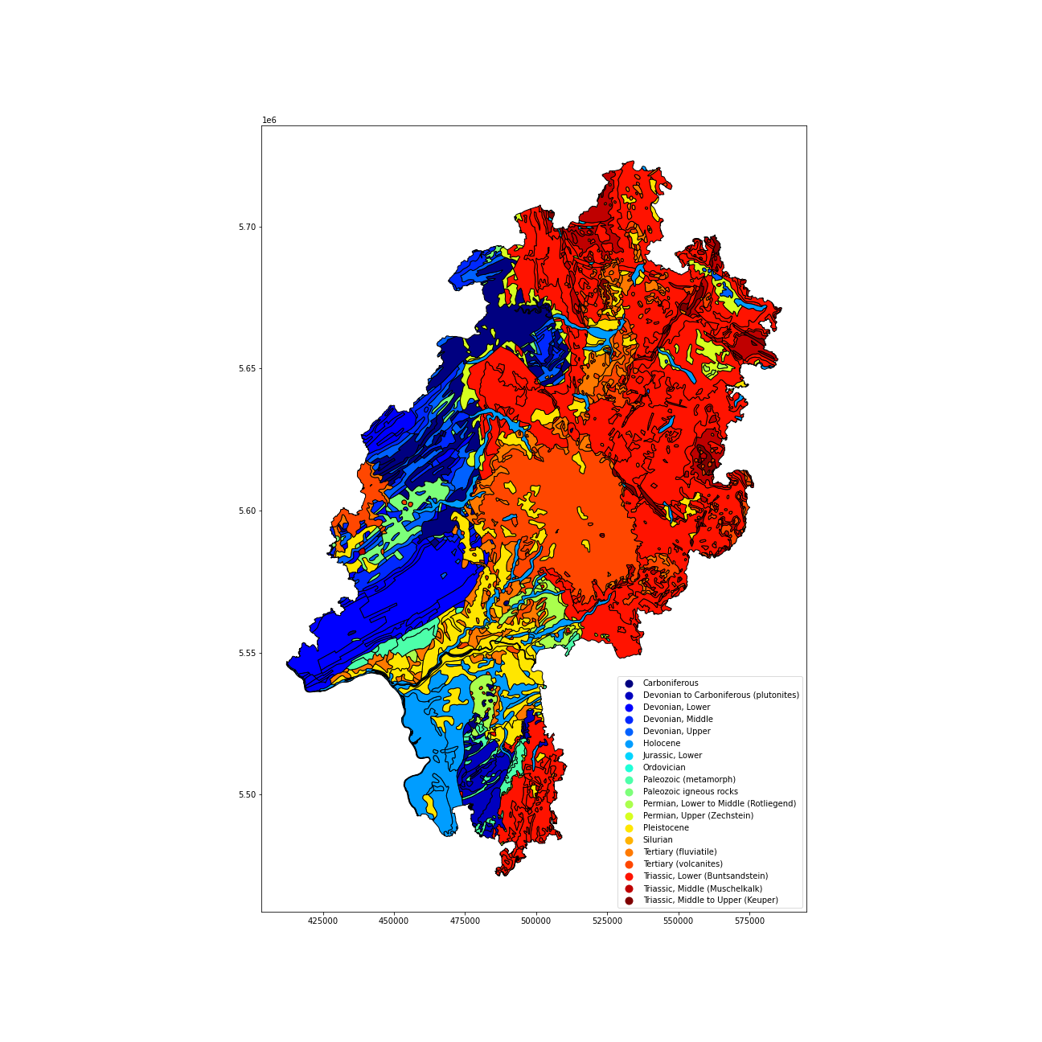
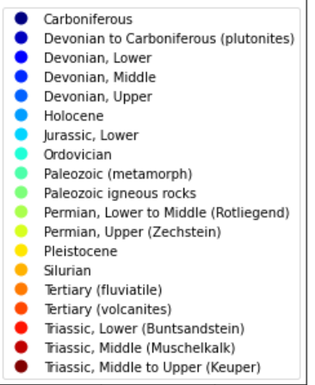
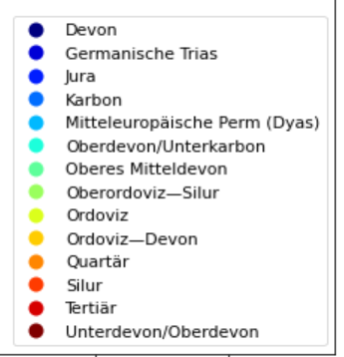
Comparing Geology classification 1.
Geo300k
Class =SYSTEM
Geo300k_Laura
Class =hlnug

Slide 12
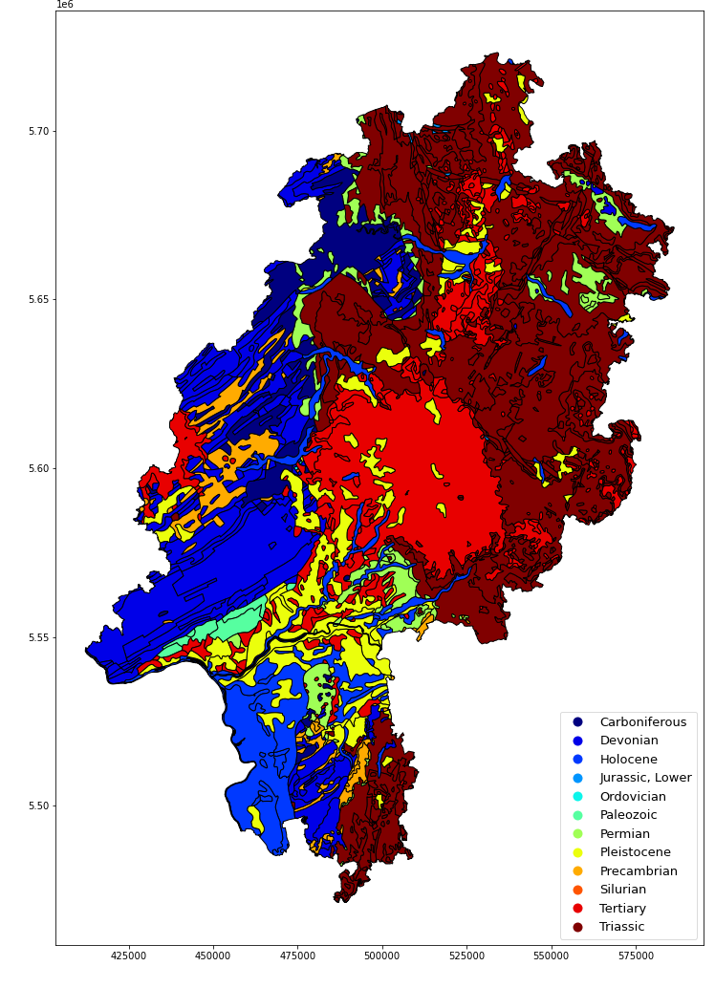
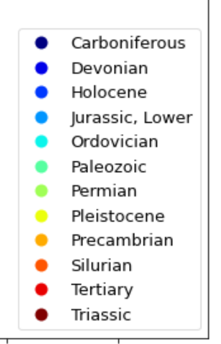
Comparing Geology classification 2.
Geo300k_Laura
Class = hlnug
Geo300k
Class =strata_condense
Which classification is suitable, and the order of importance

Slide 13
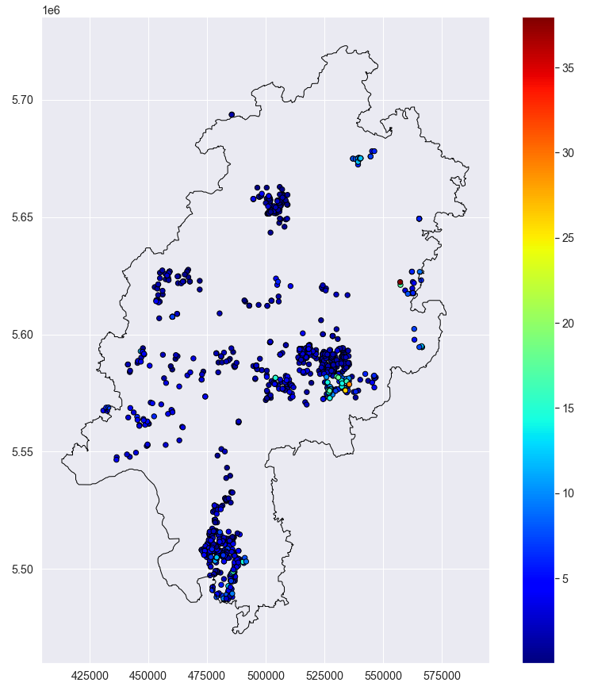
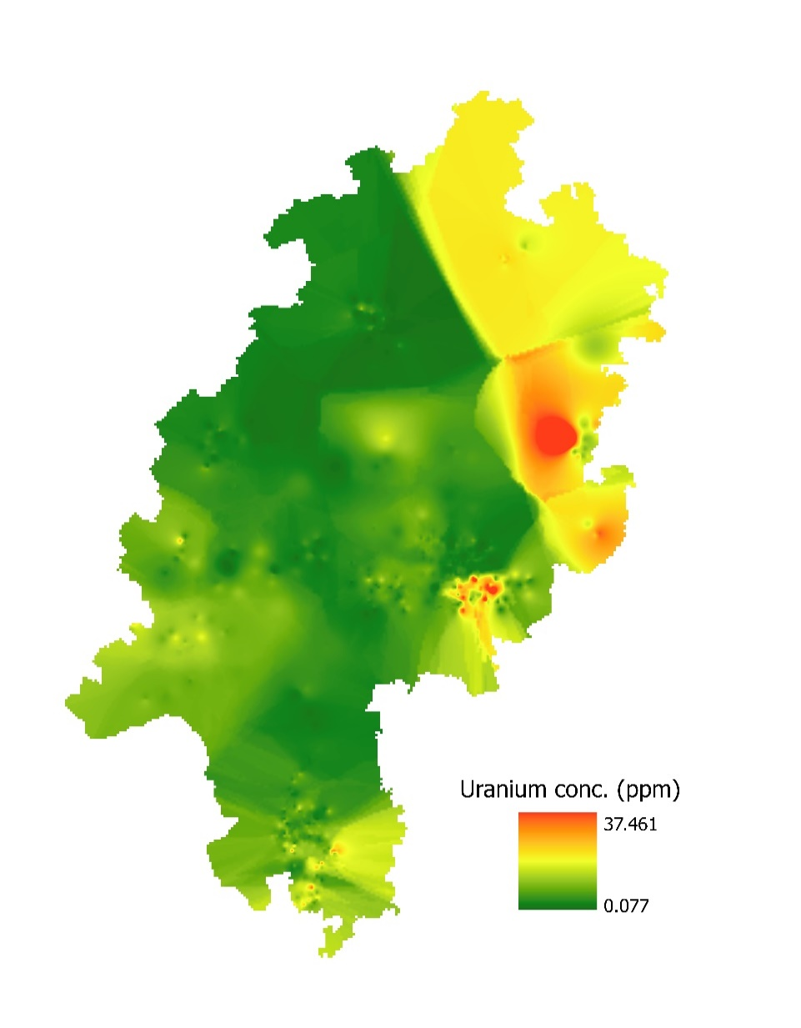
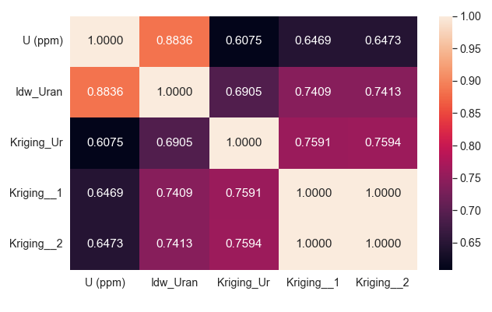
Vector Data
Vector points to raster
Uranium Data
1 data sets
- Uran_ppm_Rohda
One pt with 238 ppm was removed
Projected CRS: ETRS89 / UTM zone 32N EPSG : 25832
Four interpolation techniques were used. 1 IDW and 3 Kriging.
-IDW showed the best result

Slide 14
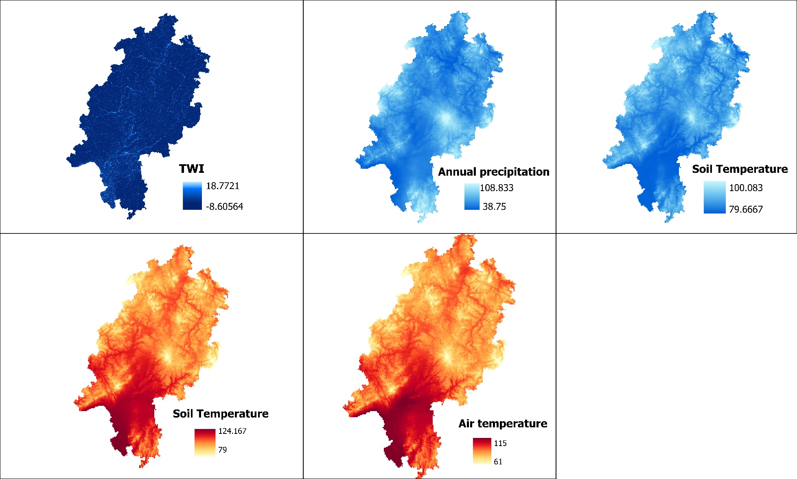
Raster Data
Climate Data
Climate data (Annual average from 1991-2020)
Three data sets
Precipitation
Air Temperature
Soil Moisture
Soil Temperature
SAGA wetness Index
Projected from: DHDN-3degGK-Zone3
To
Projected CRS: ETRS89 / UTM zone 32N EPSG : 25832
https://opendata.dwd.de/climate_environment/CDC/grids_germany/seasonal/precipitation/

Slide 15
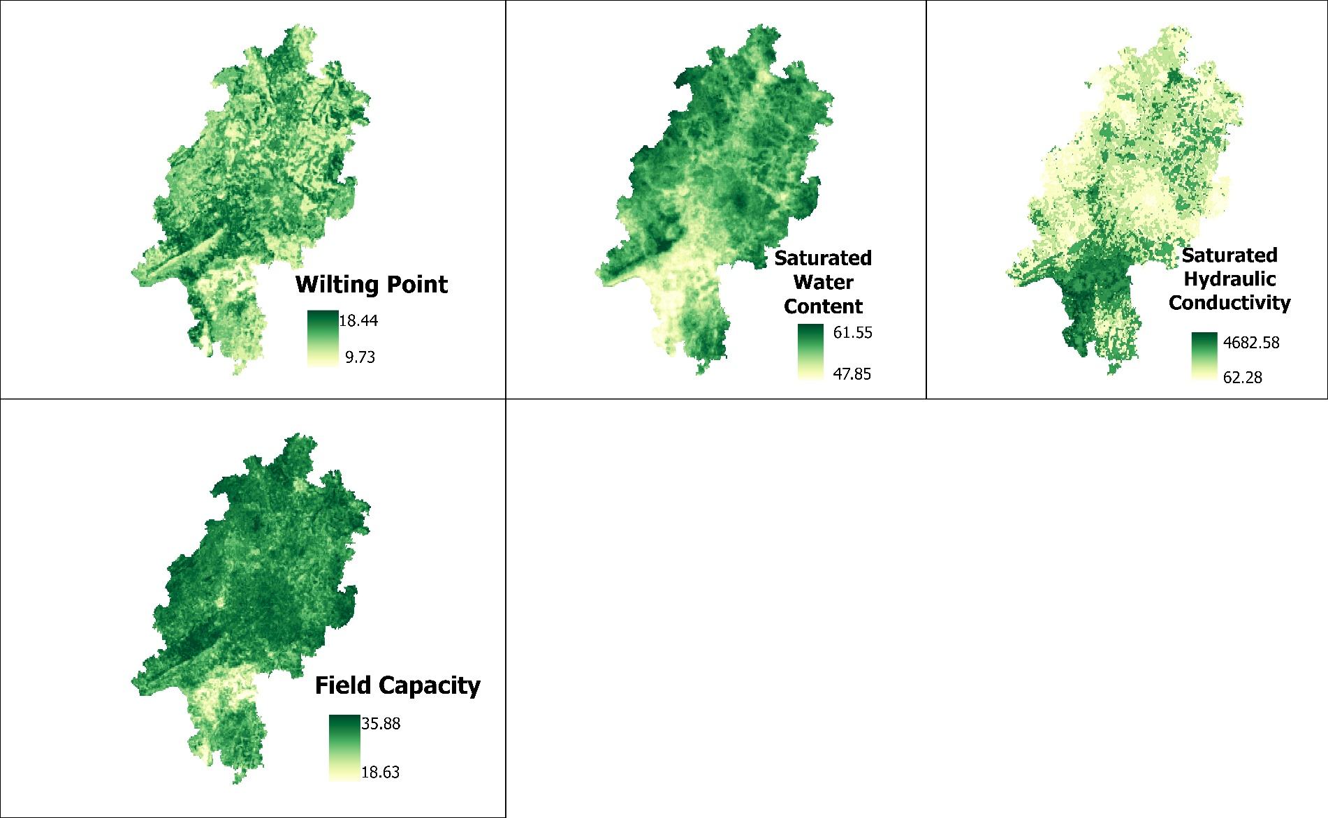
Raster Data
SOIL PROPERTIES
Soil Hydraulic properties (weighted mean of 7 layers)
4 data sets
Saturated Water Content (250km)
Saturated hydraulic conductivity (KS)
Field Capacity
Wilting point
Determination of weighted sum
-- 7 sampling depth of ( 0cm, 5cm, 15cm, 30cm, 60cm, 100cm, 200cm
-- Hydraulic properties decrease with depth
Weighted sum = [soil depth/total soil depth]
Weights were inversed
-- Projected from: GCS: WGS 1984
To
Projected CRS: ETRS89 / UTM zone 32N EPSG : 25832
-- 1k datasets resampled to 250m
https://esdac.jrc.ec.europa.eu/tmp_dataset_access_req_68430

Slide 16
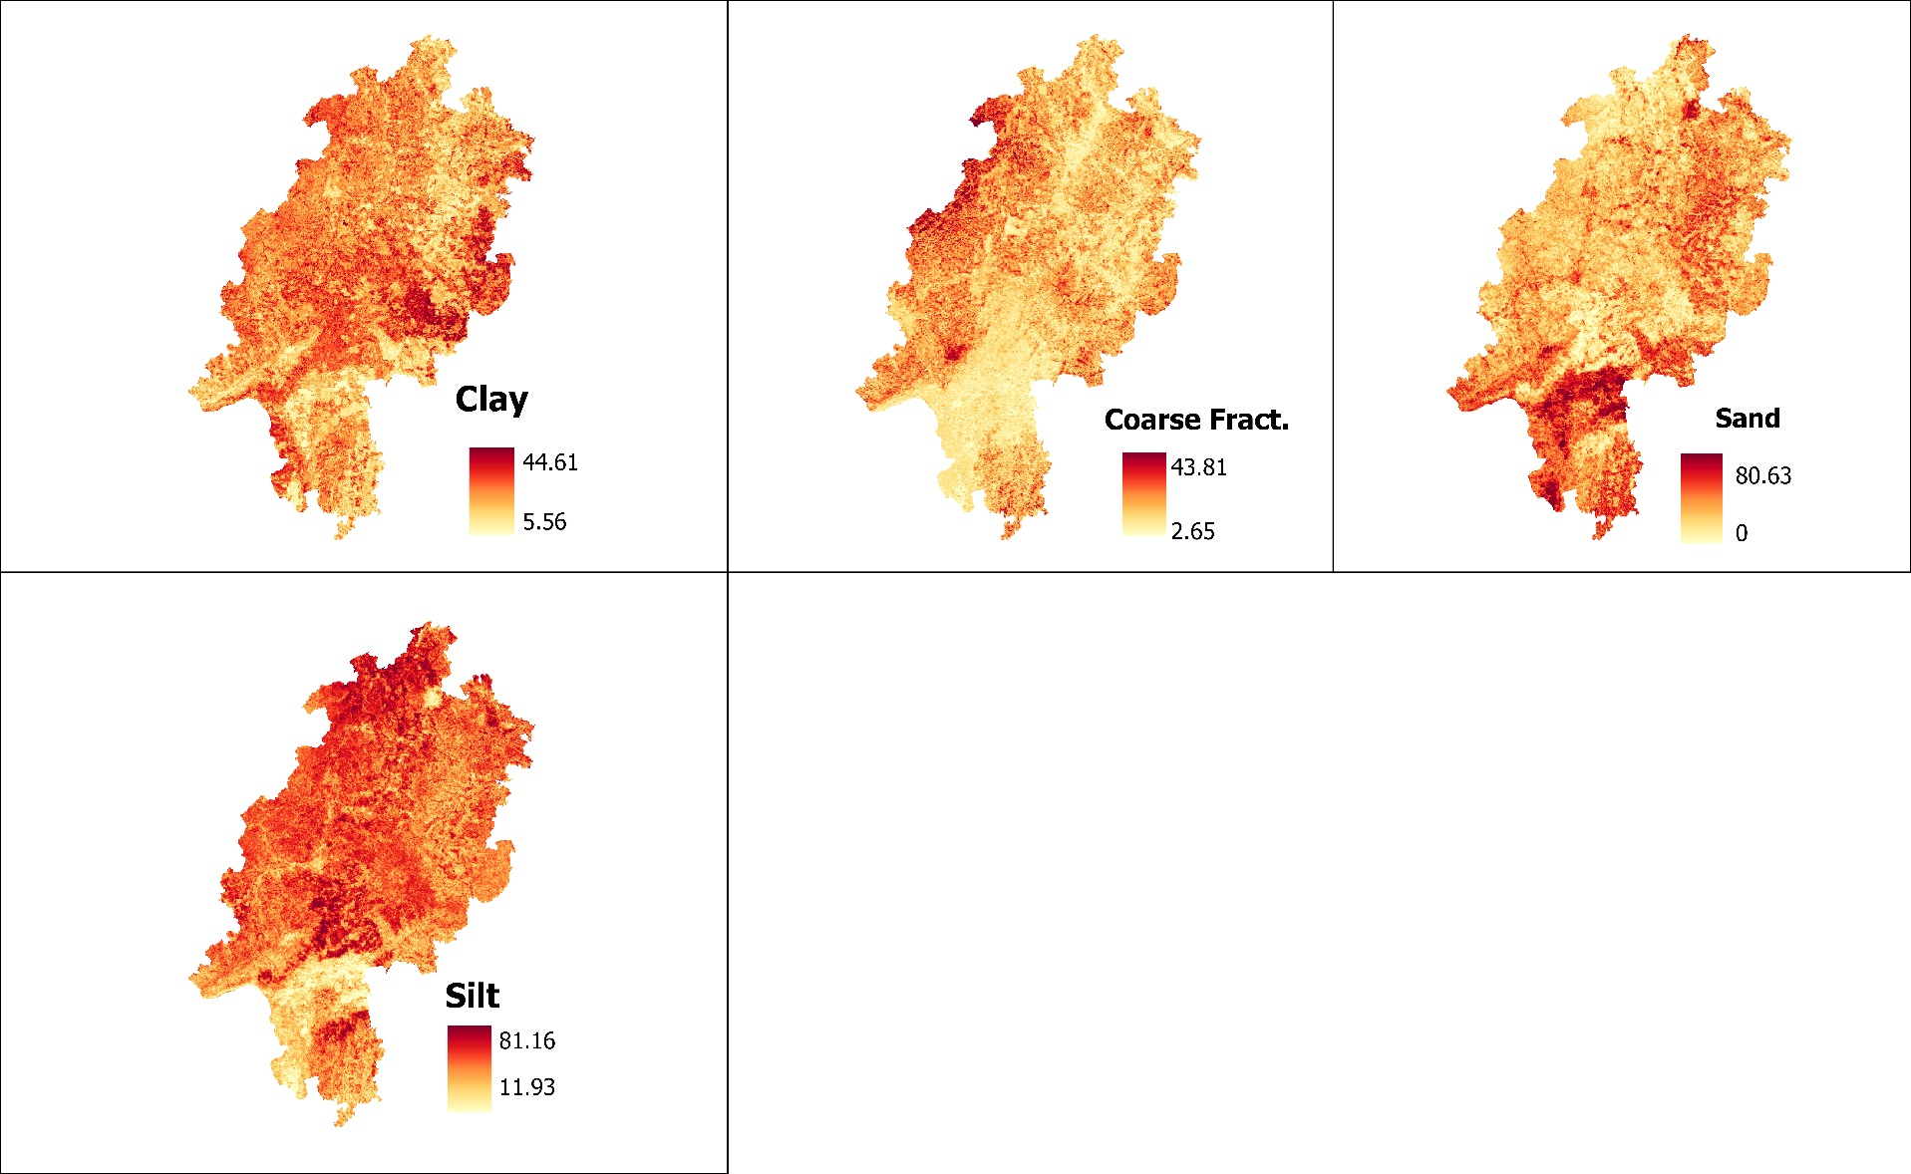
Raster Data
SOIL PROPERTIES
Soil Physical properties
4 data sets
Clay (250m)
Silt
Sand
Coarse fraction
-- Projected from: GCS: WGS 1984
To
Projected CRS: ETRS89 / UTM zone 32N EPSG : 25832
-- 1k datasets resampled to 250m
https://esdac.jrc.ec.europa.eu/tmp_dataset_access_req_68430

Slide 17
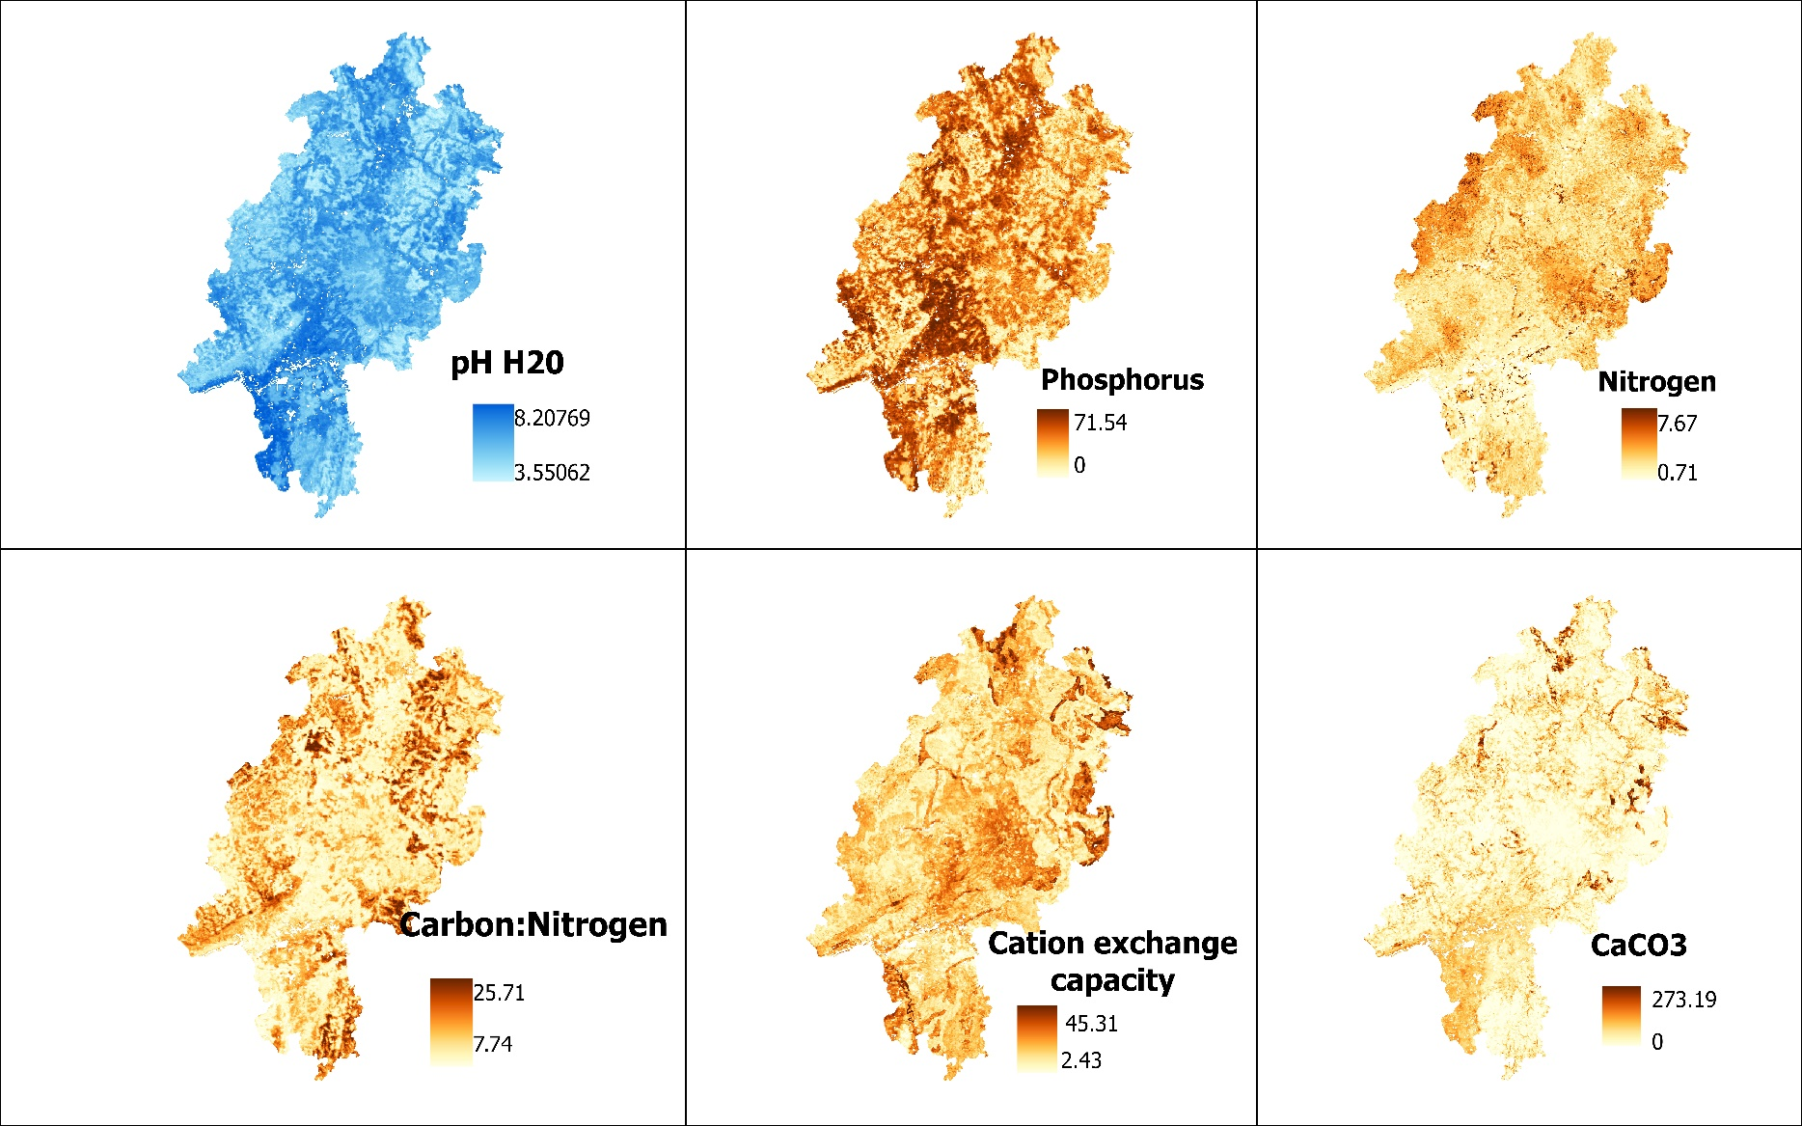
Raster Data
SOIL PROPERTIES
Soil Chemical properties
6 data sets
PH (250m)
Cation exchange
Carbon:Nitrogen (C_N)
CaC03-
Nitrogen
Phosphorus
-- Projected from: GCS: WGS 1984
To
Projected CRS: ETRS89 / UTM zone 32N EPSG : 25832
-- 1k datasets resampled to 250m
https://esdac.jrc.ec.europa.eu/tmp_dataset_access_req_68430

Slide 18
Raster Data
SOIL PROPERTIES
Soil Chemical properties
6 data sets
PH (250m)
Cation exchange
Carbon:Nitrogen (C_N)
CaC03-
Nitrogen
Phosphorus
-- Projected from: GCS: WGS 1984
To
Projected CRS: ETRS89 / UTM zone 32N EPSG : 25832
-- 1k datasets resampled to 250m
https://esdac.jrc.ec.europa.eu/tmp_dataset_access_req_68430

Slide 19
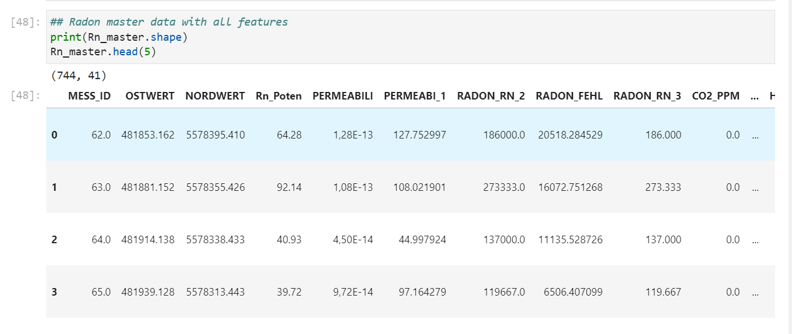
Final Extracted Data *

Slide 20
Outstanding work
Feature selection
Algorithm being built
Model selection and building
In progress
Model validation and performance metrics
Not yet started
Publishing results as a webmap
Not yet started
THESIS
Literature review and structure of thesis in progress

Slide 21


